Slide 1
Growth Hacking
Social Media Marketing – SMM
Twitter Marketing

Slide 2
→Introduction to Twitter →Twitter Marketing Terminology →Twitter Lists and Trends →Twitter Marketing for Brand Awareness →Twitter Marketing for Lead Generation → Social Media for listening and monitoring/Social Media response management → Twitter Ads → Twitter Analytics → Twitter tools – Crowdfire, Tweriod, Hashtagify, Warble
SMM –Twitter Marketing - Agenda

Slide 3
What is Twitter?
Twitter is for microblogging(blogging in short form) blogs – are articles written in web, people express their thoughts and ideas.
Twitter is for real-time updates and news
Twitter is for opinions and opinionated people(helpful in identifying the characteristics of target audience)
Twitter is for a ‘public’ person(All tweets are public until you change the settings)

Slide 4
Twitter vs Other Social Networks
140 character limit
Public platform
The Twitter Feed is only partly algorithmic

Slide 5
Twitter Marketing Terminology
Profile– Twitter doesn’t have page unlike FB
Tweet – is a 140 character post on twitter
Follow – you can only follow a profile like the way you add friends in FB
@Handle - is a unique username on twitter.
Mention – is a tweet that contains a users @handle in it
Hashtag – binds together to a particular topic, a common thread that binds around a certain topic or conversation.(search for a particular topic)
Notes:
Profile – personal
Page – Business
Group – Community or forum

Slide 6
Twitter Marketing Terminology
Direct Message – similar around inboxing . You can DM only those who follow you.
Like –same as FB
Retweet – Equivalent to share in FB
Reply – its like comment in FB

Slide 7
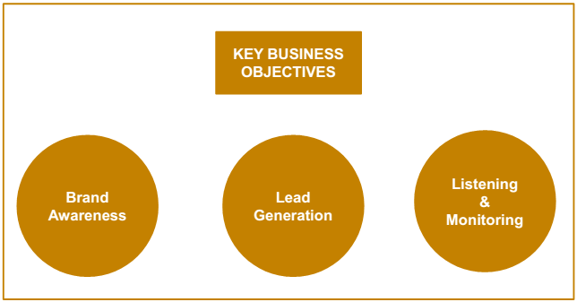
Twitter for Marketing

Slide 8
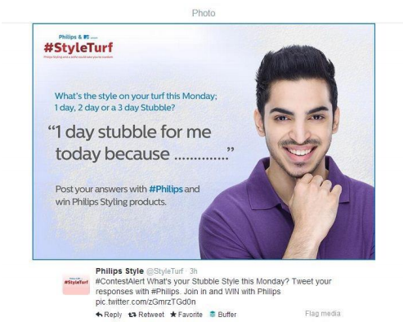
Twitter for Brand Awareness –Twitter Contest

Slide 9
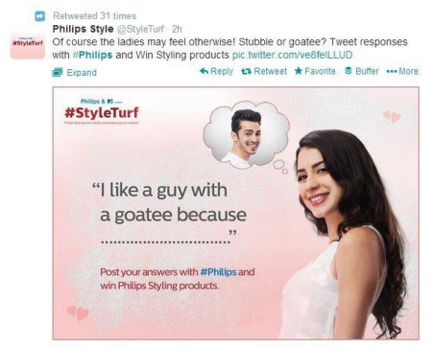
Twitter for Brand Awareness –Twitter Contest

Slide 10
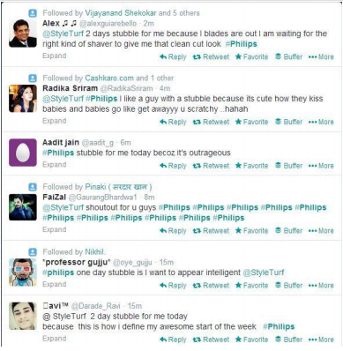
Twitter for Brand Awareness –Twitter Contest

Slide 11
Key Factors that influencing Trending
Volume of Tweets
Frequency of Tweets
Number of Unique users tweeting
Twitter influencers tweeting
Though trending can increase reach exponentially, it does not generally have any significant business impact such as an increase in enquiries/sales

Slide 12
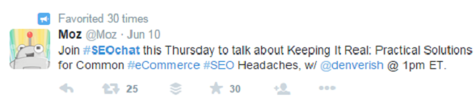
Tweetchats – for brand awareness
A group of people coming together on twitter for about an hour at regular intervals to have a conversation that resolves around a pre-determined hashtag.

Slide 13
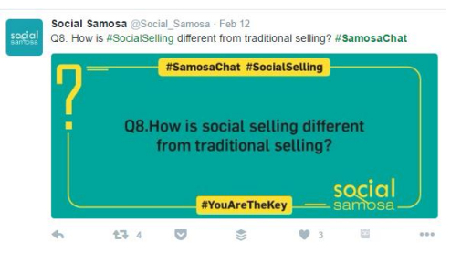
Tweetchats

Slide 14
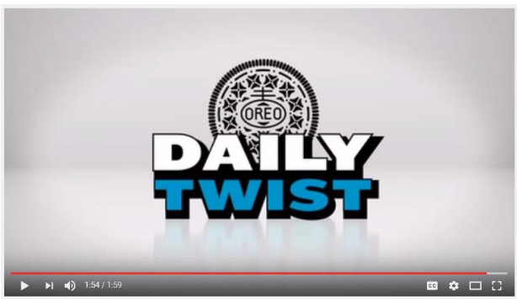
Leverage Trending/Topical Content
https://www.youtube.com/watch?v=ZDSc0V3AEnk

Slide 15
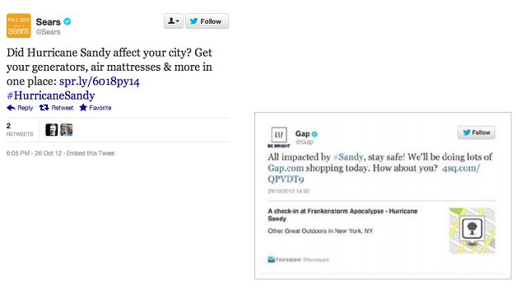
How not to Leverage Topical Content

Slide 16
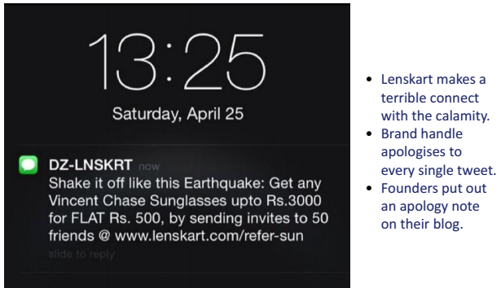
How not to Leverage Topical Content

Slide 17
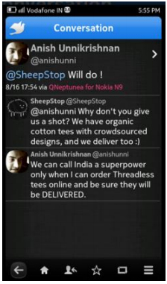
Twitter for Lead Generation
Search for keywords related to your industry, listen in for conversations happening around them and contribute where relevant
A relevant contact is far more important than a hundred random contacts
Notes:
Ensure your ad is number 1 an
Reach the exact target audience

Slide 18
TWITTER tools
Tweroid – Lets you know what is the best time to tweet.
Hastagify.me – Helps you find out what hash tag you can use
Warble – To create alerts and get notified and to listen particular accounts.
Notes:
Using the tool. To listen the conversation
Hootsuite
Warble – get email alerts for twitter conversations.
Warble.co an signup by twitter account.

Slide 19
Twitter Ads -

